Slide 1





Slide 2


Requirements Approach.
LendingFront would like to create a loan platform that would allow its customers:
To apply for a loan quickly and easily.
Loan applications go through a multi-step analysis process. The company wants
its clients to be able to see the status of their application.

Slide 3
Analysis of the process:
During the application process, the small business owner creates the login credentials (email and password) and introduces basic personal and business information. LendingFront then collects additional information, such as business credit reports, banking transactions and non-traditional data, such as yelp reviews using the basic information provided. At this point the company has all the data it needs to make an automated loan decision. The decision is presented to the user, and if the user accepts the terms of the loan is financed. If the user re-login after submitting a loan application, the system must submit the current status of the application ("Pending", "Approved", "Denied") or the loan status ("Active", "Closed") if a loan has already been granted. If the loan is active, the application must show the remaining balance of your loan, previous payment activity and outstanding payments.

Slide 4
The theorical outcome of the process:
After a loan has been granted and funded, LendingFront starts to collect daily payments. The funds collection process should be automatic. The application needs to create a daily file with all due payments. This file is sent to the ACH network and the funds are eventually deposited in LendingFront’s bank account. Next day, LendingFront receives a file with all the transactions that could not be collected. The loan platform must process this file and update the payment status accordingly.

Slide 5
Engineering design and architecture.
The possible scenarios that may be presented are:
From user experience: user registration and password, content visualization, application to a loan, filling in basic personal and business information, and status visualization of your application.
From the company’s experience: visualization of customer loan requests, visualization of yelp reviews, visualization of each customer’s creditworthiness and revision of each customer’s daily payment report.
From the experience of the software administrator: Access to the administrator panel to assign display permissions for each employee (optional), access to the database, access to the activity logs of each user/employee.

Slide 6
Description of use cases:
1.-Website login, user registration,
2.-Option to apply to a loan.
3.-Registration of basic personal information.
4.-Registration of company information.
5.-Submission of application.
6.-Status display of application.
7.-Display of approved amount, payments made and outstanding debt.
8.-Receipt of customer documentation.
9.-Yelp reviews.
10.-Credit approval or rejection.
11.-Payment report display.

Slide 7
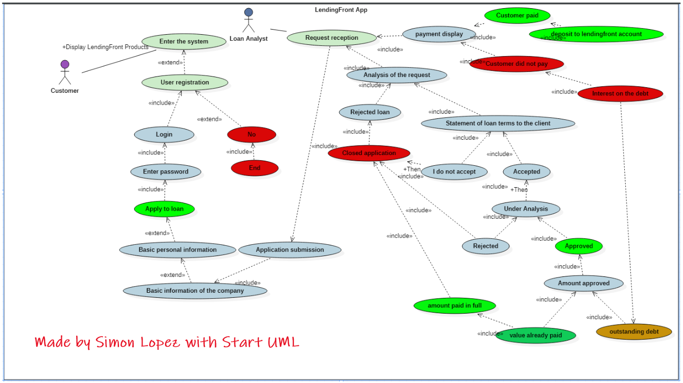
Flowchart:

Slide 8
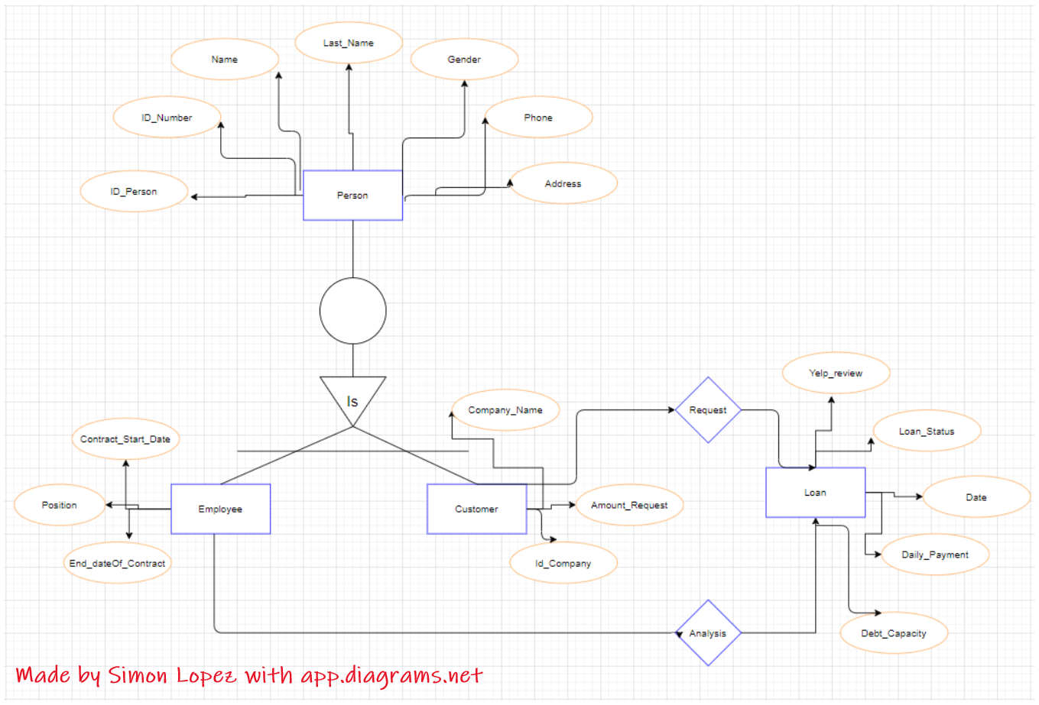
Entity-Relationship Model:

Slide 9
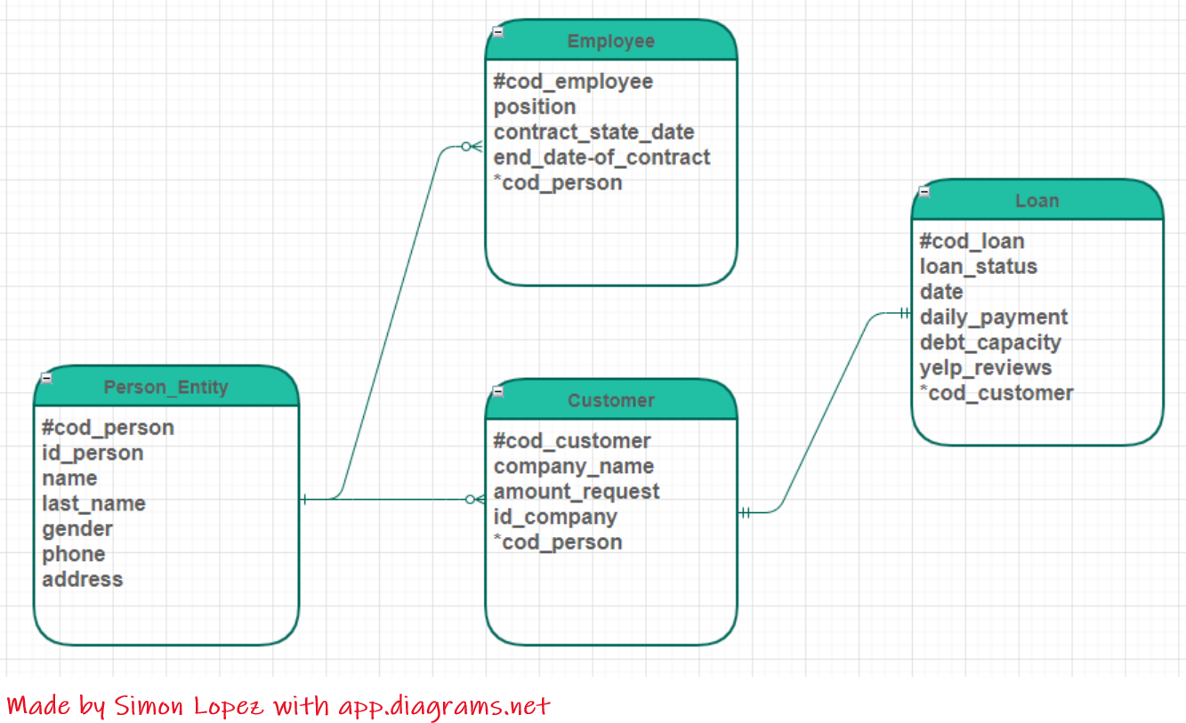
Relationship Model:

